Slide 1
RATINGS PREDICTION
By Manish Kumar

Slide 2
Problem Statement
We have a client who has a website where people write different reviews for technical products. Now they are adding a new feature to their website i.e. The reviewer will have to add stars(rating) as well with the review. The rating is out 5 stars and it only has 5 options available 1 star, 2 stars, 3 stars, 4 stars, 5 stars. Now they want to predict ratings for the reviews which were written in the past and they don’t have a rating. So, we have to build an application which can predict the rating by seeing the review.

Slide 3
Exercise
Collect reviews from online stores for different electronics and make machine learning model to predict star rating of the products from the review text.

Slide 4
Data Collection
The data for the project was collected from amazon.com for different electronics listed as laptops, Phones, Headphones, smart watches, Professional Cameras, Printers, Monitors, Home theater, Router.
The data collected contains total of 20875 text reviews and the shape of the data file was (20875, 3).

Slide 5
About Data
The dataset consisted of 2 columns, Review and Rating, where rating was the target variable.
The rating column had 5 unique values, which are 1 star, 2 stars, 3 stars, 4 stars and 5 stars.
The data was almost balanced with data distribution as 21% 1 star, 17% 2 stars, 18% 3 stars, 21% 4 stars and 23% 5 stars.

Slide 6
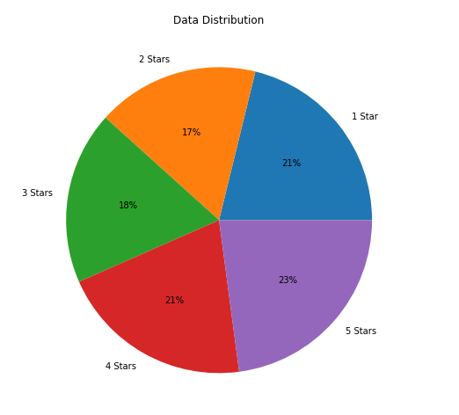
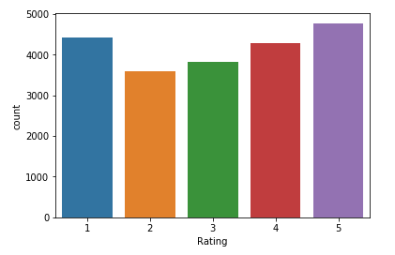
Continue...

Slide 7
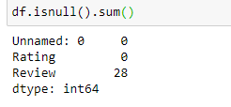
Missing Values
There were some missing values in the data, out of 20875 rows, 28 rows consisted of missing values for review column.
We dropped these rows as the number wasn’t significantly large relatively.

Slide 8
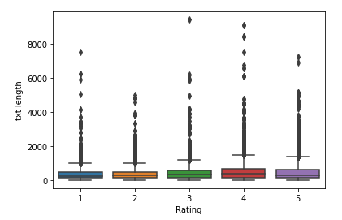
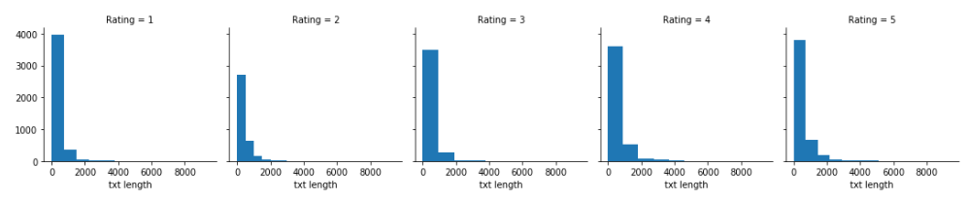
EDA
The mean value for text length was around 450 words. Even for all the ratings separately the value was around 500 words.

Slide 9
Data Preprocessing
The entire text reviews were converted into matrix of token counts with the help of CountVectorizer which was imported from the scikit learn library.
TF-IDF, that is, term frequency inverse document frequency was also used with the help of TfidfTransformer which was also imported from scikit learn library.
From nltk corpus stopwords were imported and used to filter out stopwords from the data.

Slide 10
Model Building
We will train 3 models and select the best performing model out of these.
The model we will train are MultinomialNB, Decision Tree Classifier Random Forest Classifier.

Slide 11
Model Evaluation
For evaluation of our models we will use f1 score, precision, recall and accuracy of the model.
All this can be viewed with the help of classification report which we imported from sklearn.metrics.

Slide 12
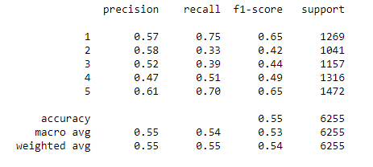
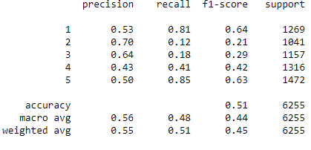
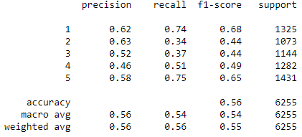
Multinomial NB
The accuracy score of multinomial nb after using countvectorizer only was 0.55. But it increased to 0.56 after removing stopwords.
The accuracy dropped with the use of tf-idf to 0.51.

Slide 13
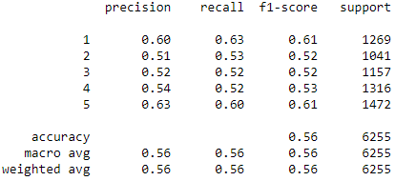
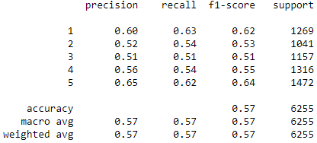
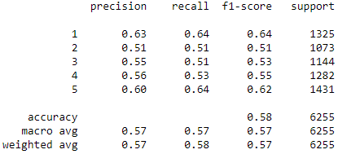
Decision Tree Classifier
The accuracy score of decision tree classifier after using countvectorizer only was 0.56. But it increased to 0.58 after removing stopwords.
The accuracy dropped with the use of tf-idf to 0.57.

Slide 14
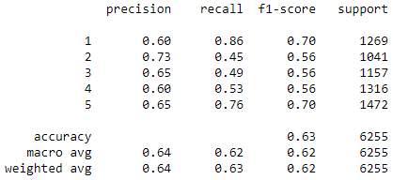
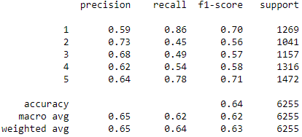
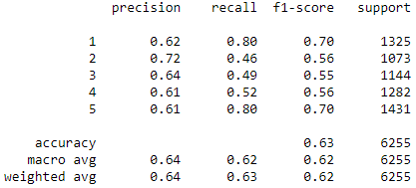
Random Forest Classifier
The accuracy score of decision tree classifier after using countvectorizer only was 0.63. It showed no change and stayed to 0.58 after removing stopwords.
The accuracy increased with the use of tf-idf to 0.64.

Slide 15
Conclusion
In this project we learned about the review and rating systems of online stores.
While collecting the data from the websites with the help of selenium, we learned how most of the reviews are either 5 stars or 4 stars, i.e., Very Good or Good or they were 1 stars, i.e., Bad. We did find 2 stars and 3 stars review but they were not as popular as 5,4 or 1.
We created a model which could help in predicting the star ratings for the product after processing the review for the said product. We learned about various NLP techniques like count vectoriser, tf-idf, etc.

